Slide 1

LOAN DEFAULT
EDA CASE STUDY

Slide 2

Our Team
N. DRUVA SADVIK KUMAR
(Data Science intern)
P. MOUNIKA SRIVALLI
(Data Science intern)

Slide 3

Agenda
This case study aims to identify patterns which indicate if a client has difficulty paying their instalments which may be used for taking actions such as denying the loan, reducing the amount of loan, lending (to risky applicants) at a higher interest rate, etc.
This will ensure that the consumers capable of repaying the loan are not rejected.
Identification of such applicants using EDA is the aim of this case study.

Slide 4
CONTENTS
Categorical Univariate analysis for target 0
Categorical Univariate analysis for target 1
Categorical Univariate analysis for variables target 0
Categorical Univariate analysis for variables target 1
Bivariate analysis for target 0
Bivariate analysis for target 1
Univariate analysis after merging previous data
Bivariate analysis after merging previous data

Slide 5
Categorical Univariate analysis for target 0

Slide 6
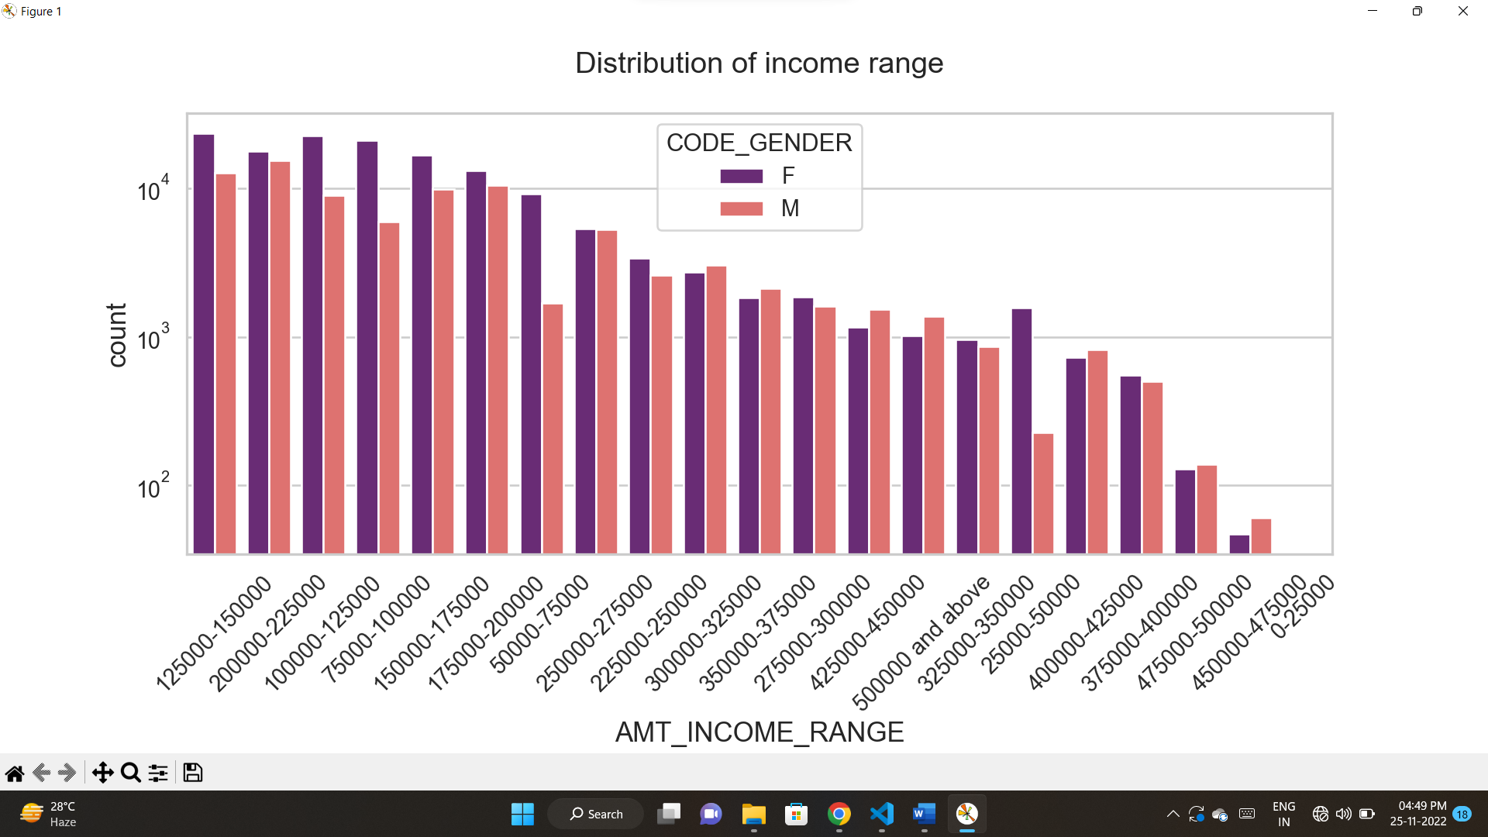
from this graph we can observe that
there are a greater number of credits in 100000-200000
in that range there are number of females
very less count of credits presents at 450000-475000
No one is there at 0-25000

Slide 7
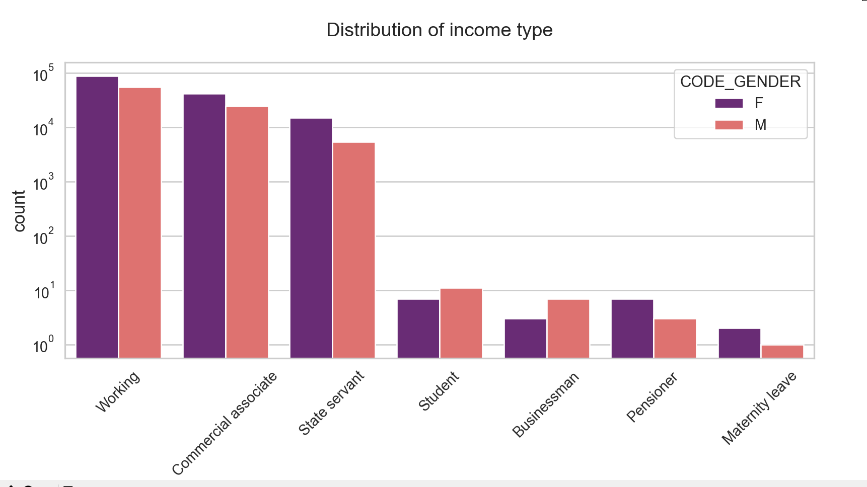
From this graph we can observe that
Working, Commercial associate and state servant are having high range of income.
For this range, females are majority.
Student, Businessman, Pensioner and Maternity leave has less range of income

Slide 8
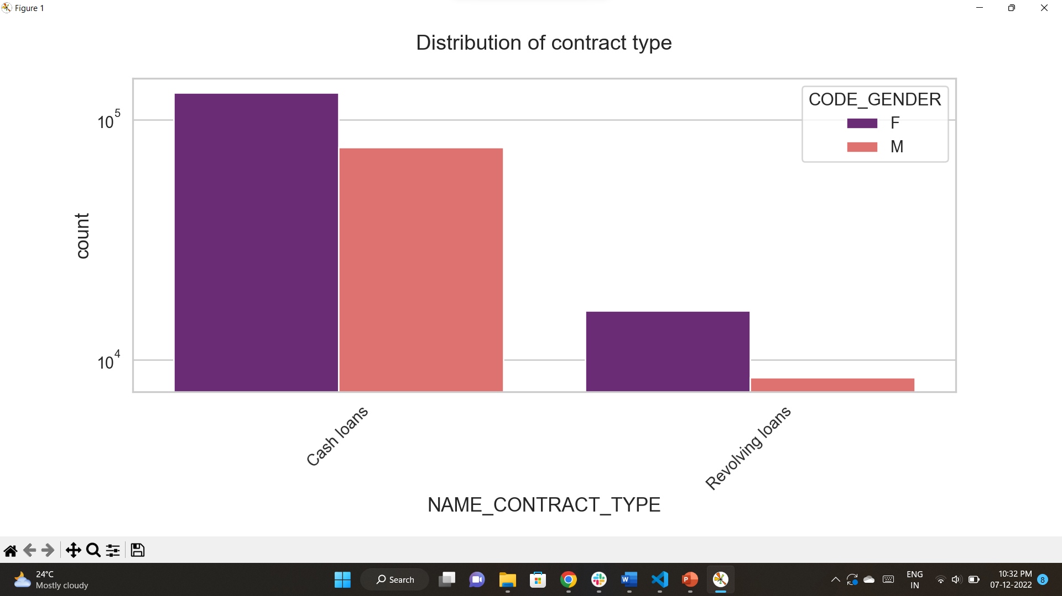
From this graph we can analyze that
Cash loans are in higher count
Females are more in this range

Slide 9
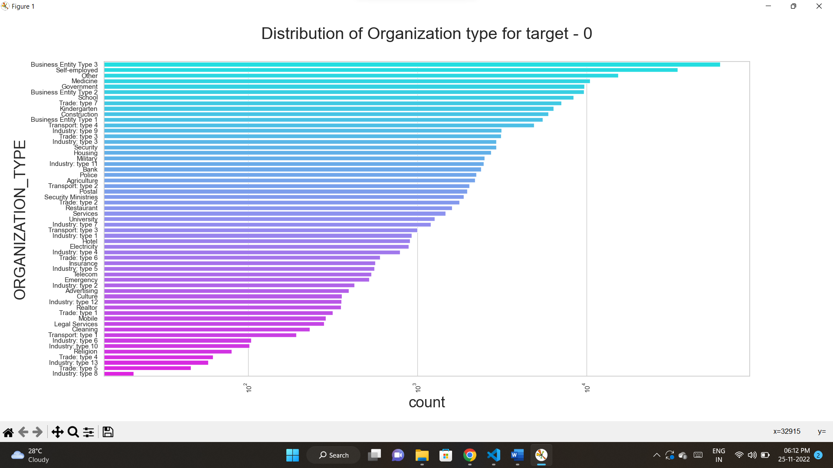
From this graph we can analyse that
Business entity type 3, self-employed, other, medicine and Government has more number of clients.
Religion, trade: type 4,industry:type 4, industry:type 13, trade:type 5, industry: type 8 has less number clients

Slide 10
Categorical Univariate analysis for target 1

Slide 11
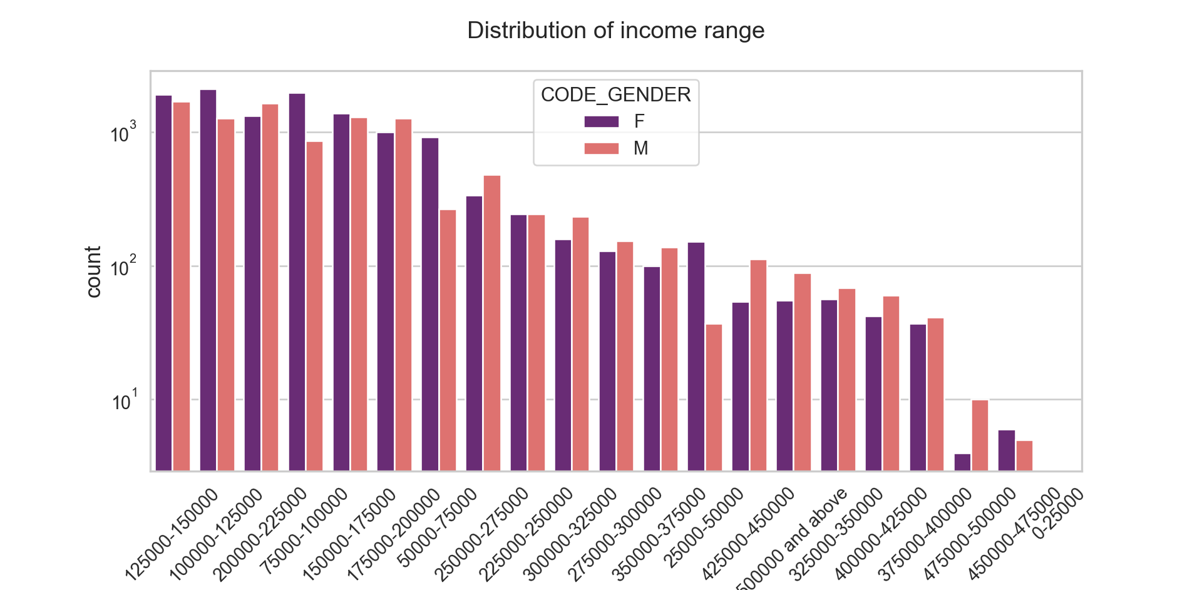
from this graph we can analyze that
there are a greater number of count from 100000 – 200000 range
there are more females than male
there are less number of credits greater than 400000

Slide 12
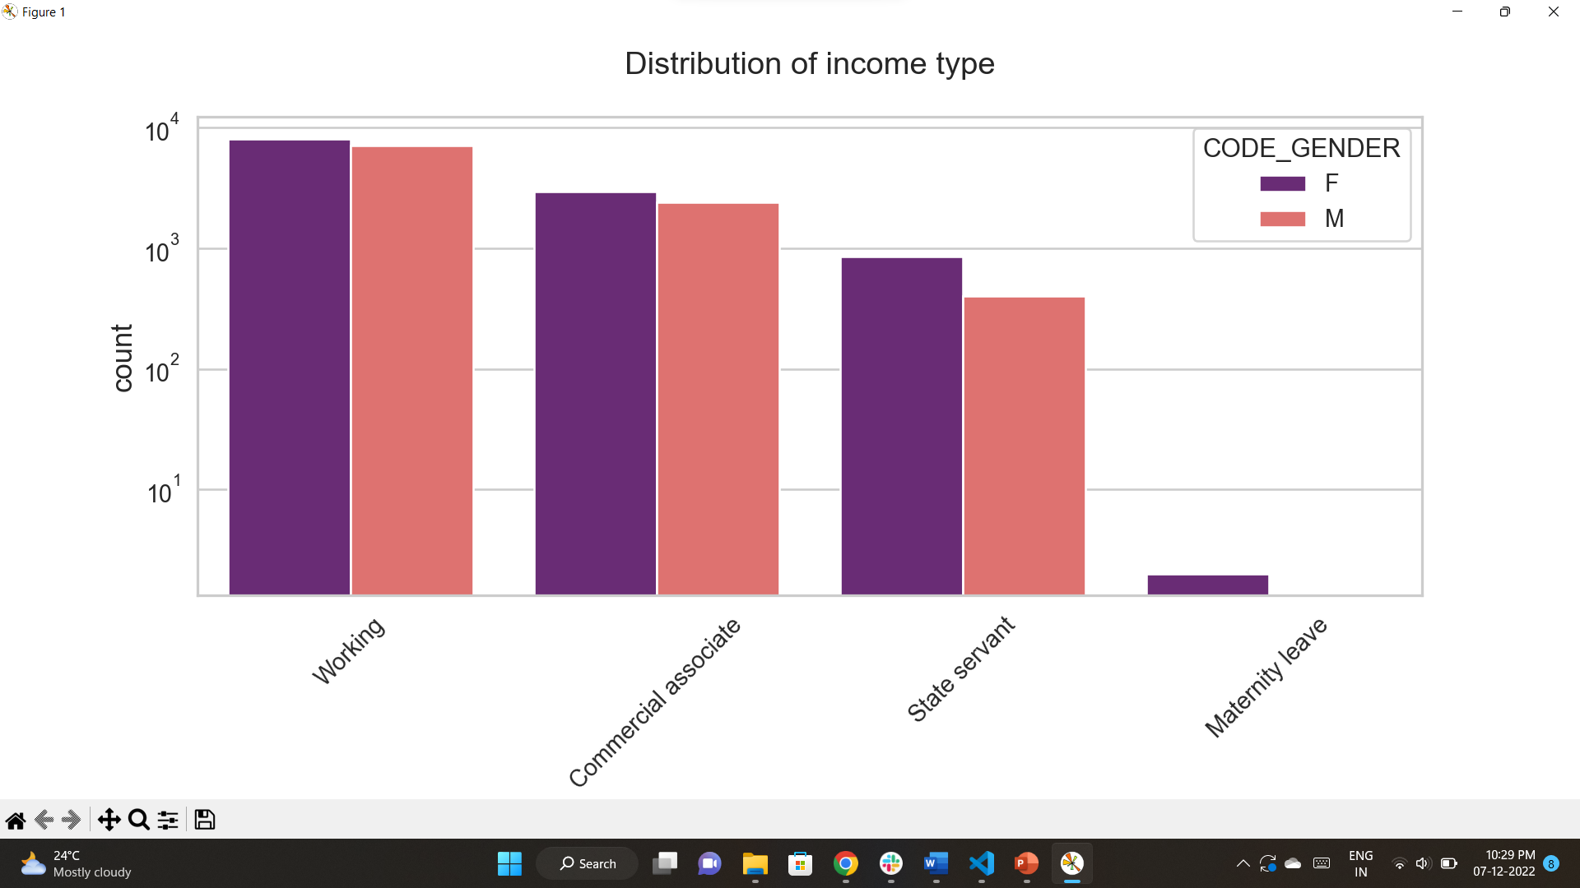
From this graph we can analyse that
Working, commercial associate has more range of income
In that range female are greater than male
State servant and maternity leave has less range of income
In that range also females are greater than male

Slide 13
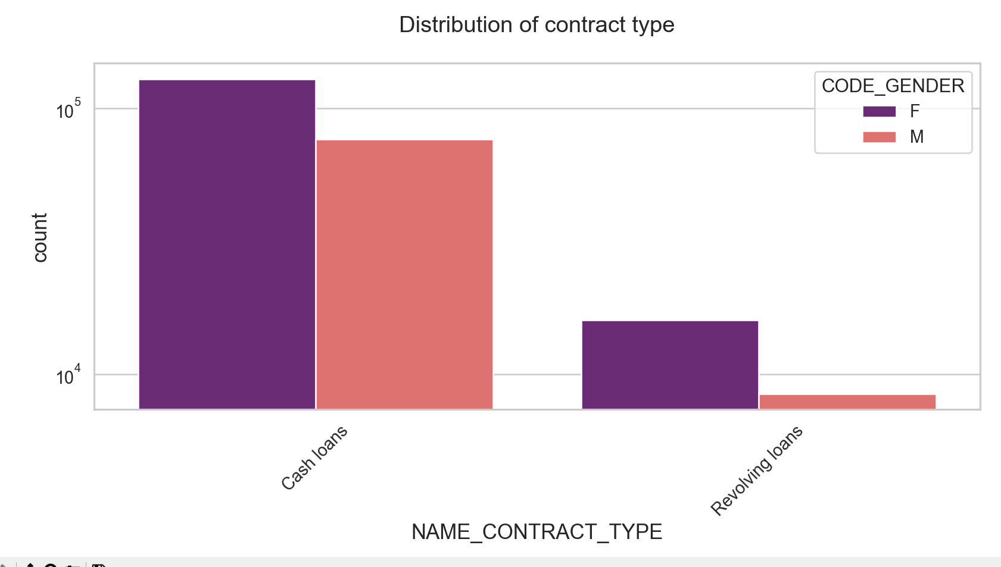
From this graph we can analyse that
Cash loans are more than revolving loans
In this too Females are greater

Slide 14
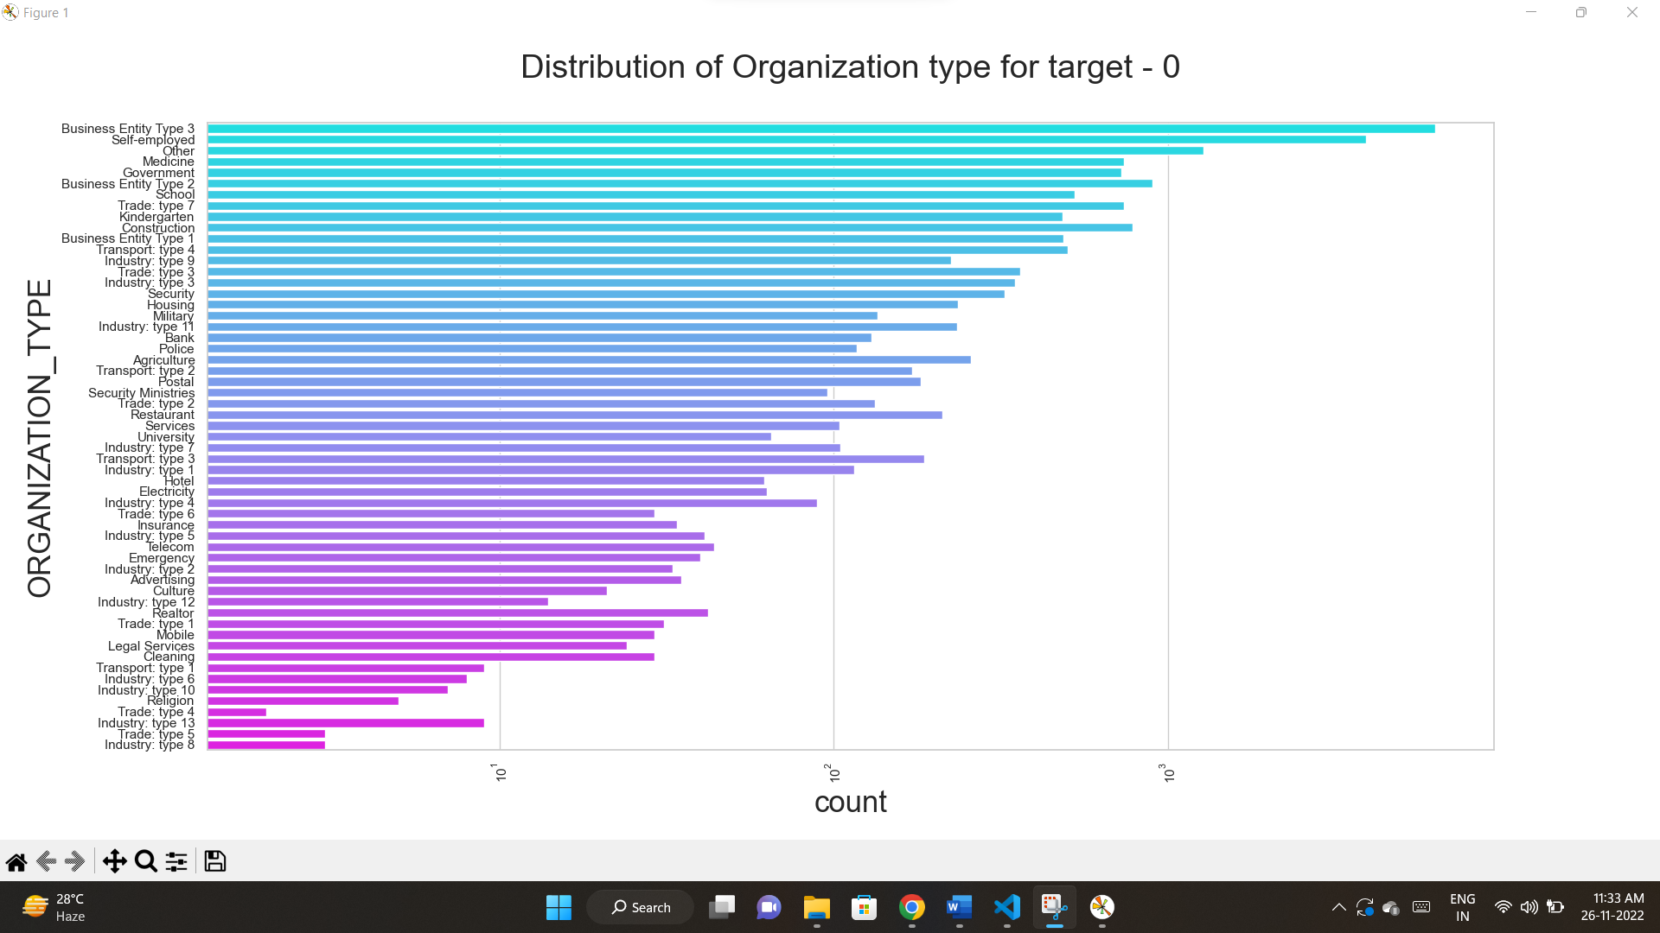
From this graph we can analyze that
Business entity type 3, self-employed, other, medicine and Government has a greater number of clients.
Religion, trade: type 4,industry:type 4, industry: type 13, trade:type 5, industry: type 8 has less number clients

Slide 15
Categorical Univariate analysis for variables target 0

Slide 16
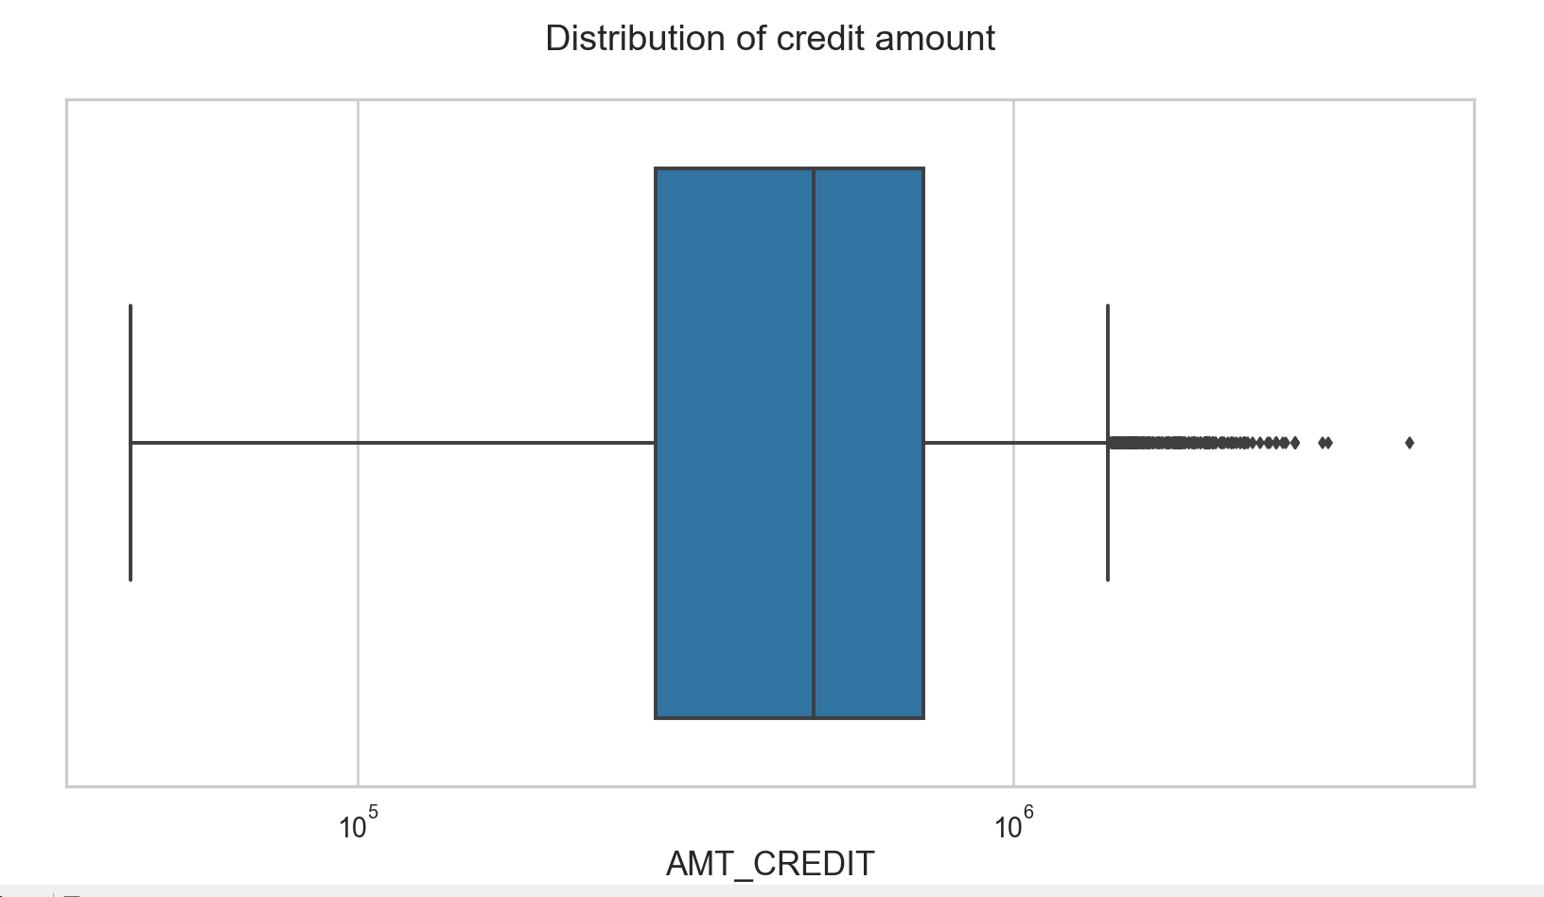
From this graph we can conclude that
Q1 is bigger than Q3 many of customers lies in Q1
There are outliers in credit distribution

Slide 17
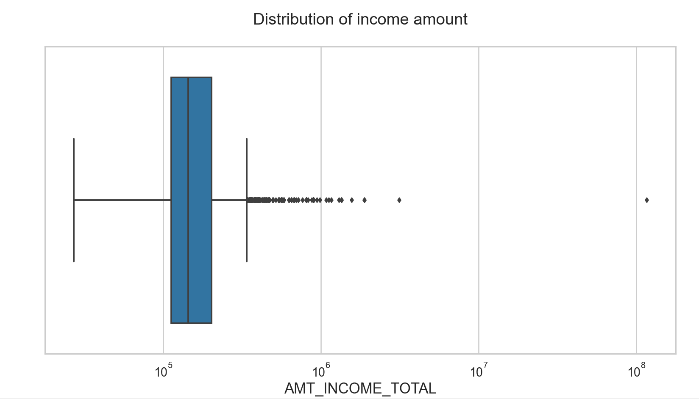
There are some outliers in income distribution
q1 in bigger than the q3 so the more customers are in q1

Slide 18
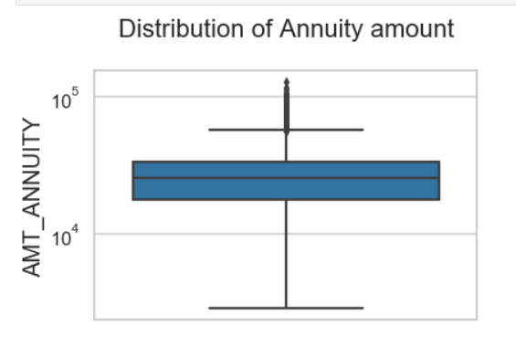
there are some outliers in the AMT_ANNUITY
First quartile is bigger than the third one. so many of outliers present in the first outlier.

Slide 19
Categorical Univariate analysis for variables target 1

Slide 20

Q1 is larger than the q3
Some outliers also present in the graph.

Slide 21
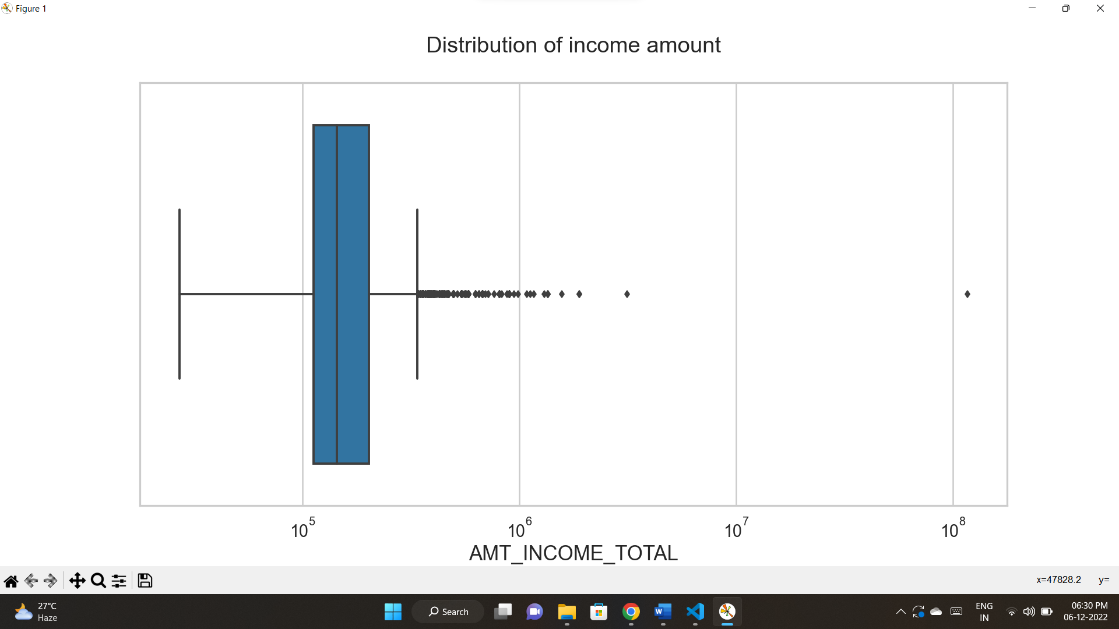
There are some outliers in income distribution
q1 in bigger than the q3 so the more customers are in q1

Slide 22
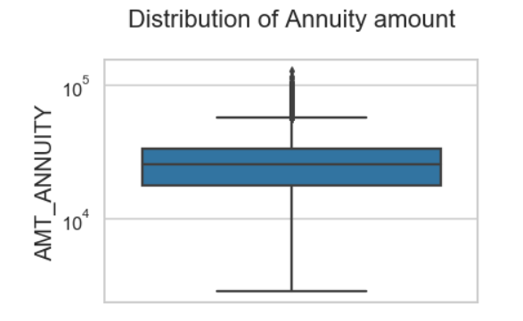
there are some outliers in the AMT_ANNUITY
First quartile is bigger than the third one. so many of outliers present in the first outlier.

Slide 23
Bivariate analysis for target 0

Slide 24
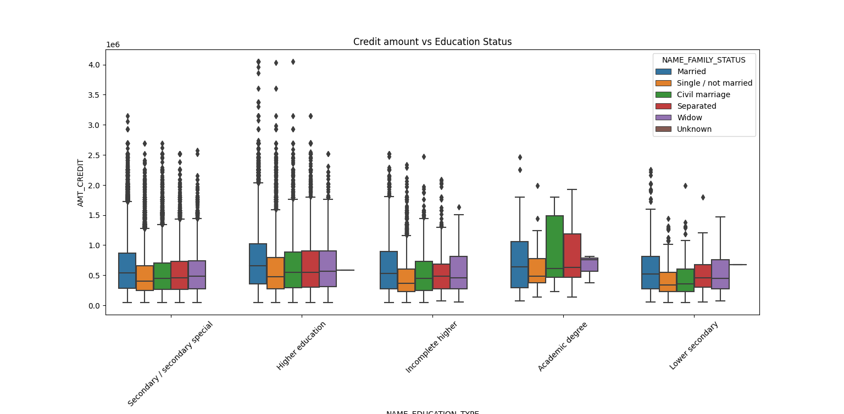
Academic degree of married, Civil marriage separated has a greater number of credits than any other else.
Higher education of family status married, single, civil marriage has a greater number of outliers.
3rd quartile of civil marriage in academic degree are having greater number of credits than any others

Slide 25
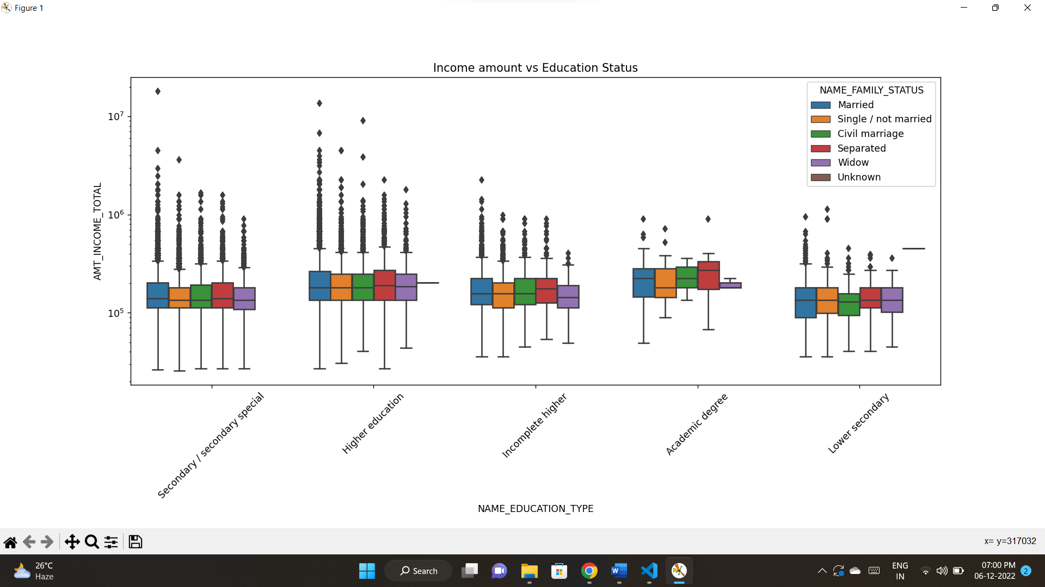
In Higher education, almost family types have same income amount.
And it also contains outliers.
Academic degree has a smaller number of outliers.
Lower secondary has less income amount than others.

Slide 26
BI-VARIATE ANALYSIS FOR TARGET 1

Slide 27
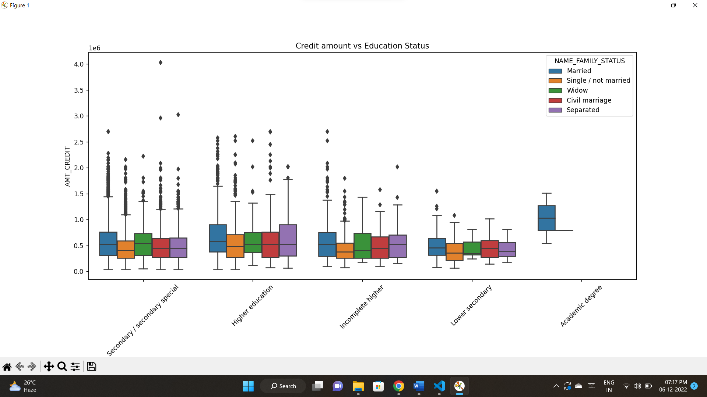
In Academic degree married has a greater number of amount credit and this doesn’t contain any outlier.
Lower secondary group has less number of credits compare to others.

Slide 28
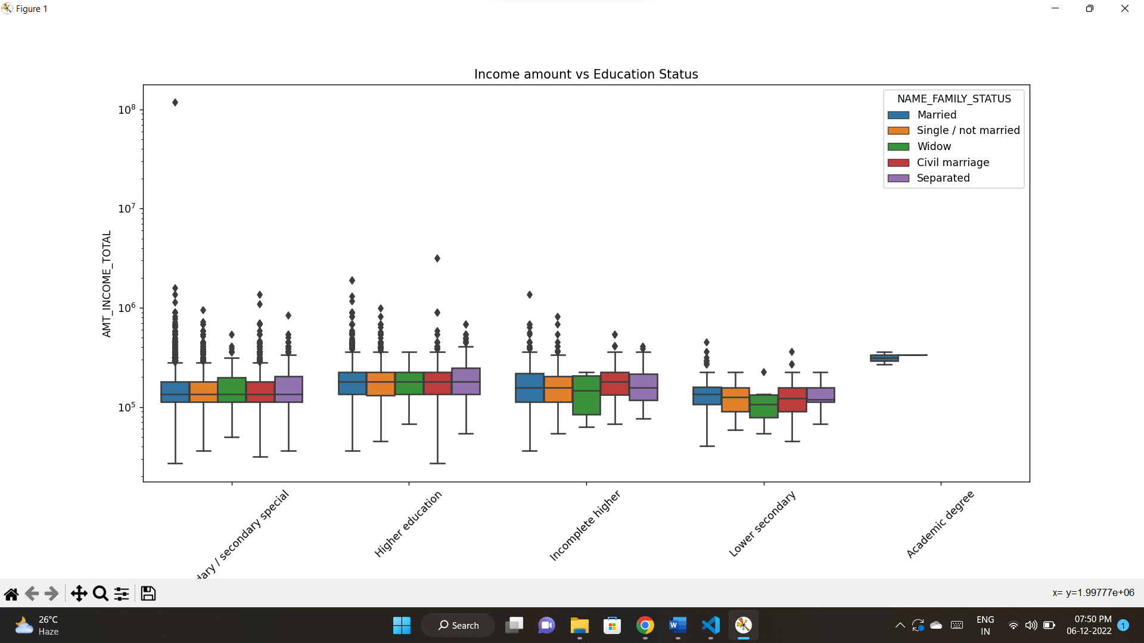
From this graph we can say that,
Academic degree has only one status that is married. This has more income and no outliers.
Almost all status of Higher education has almost same income.
Lower secondary has less income than others.

Slide 29
Univariate analysis after merging previous data

Slide 30
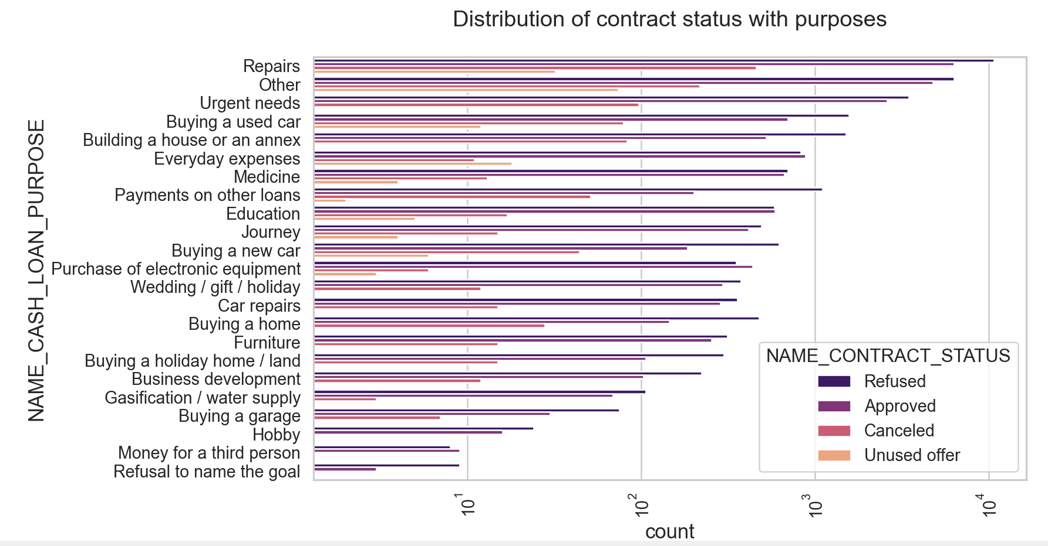
Most of loans are cancelled in Repairs
Most of loans are approved in Repairs
Less number of approved loans are in Refusal to name the goal.

Slide 31
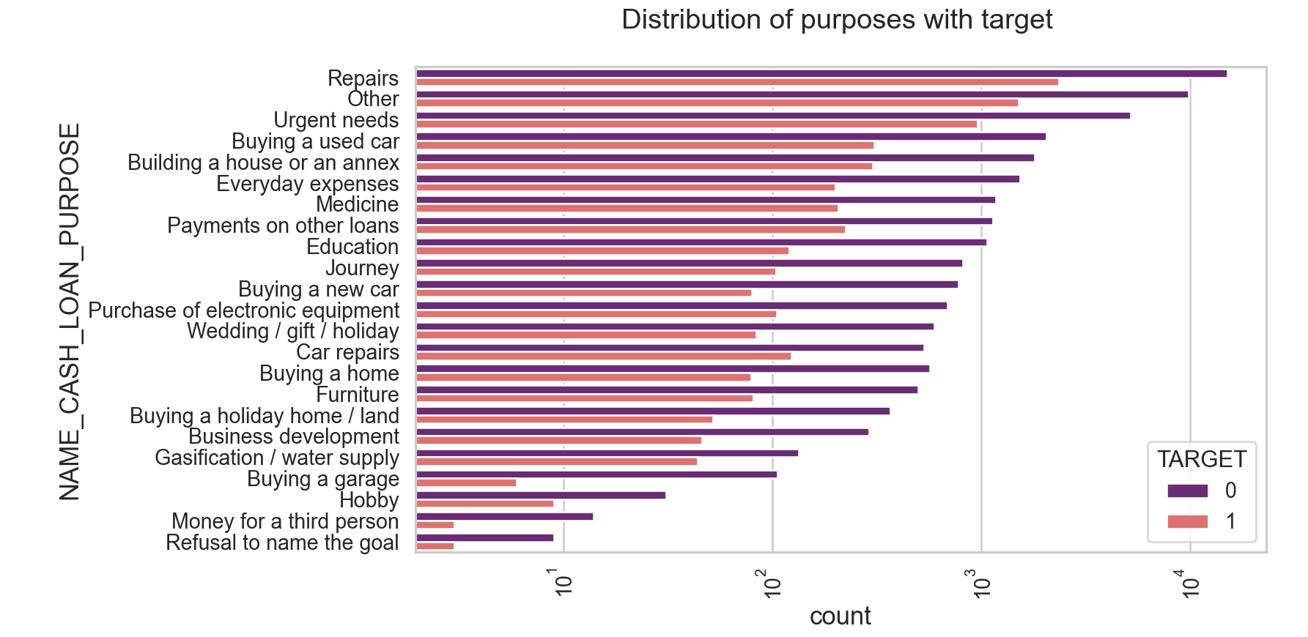
Repairs has difficulties in payment of their loans.
Least number of loans are in Refusal to name the goal with target 1.

Slide 32
Bivariate analysis after merging previous data

Slide 33
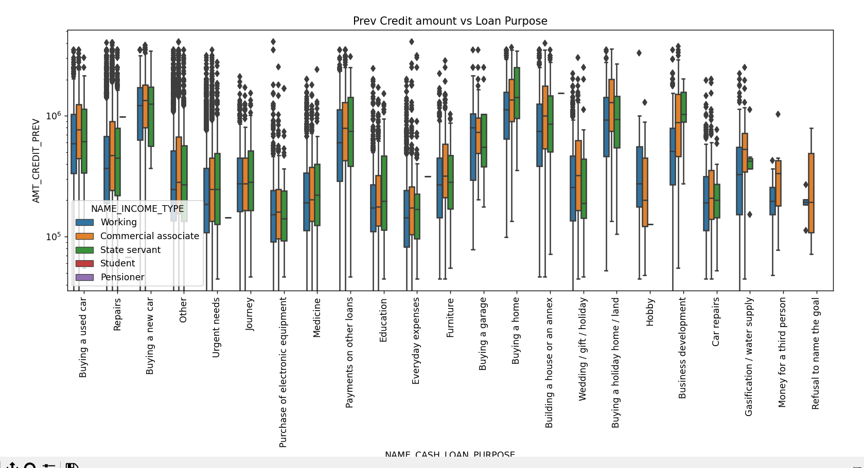
Loan purpose of house buying has more amount of credit.
Least amount credited to purchase of Electronic equipment, Everyday expenses

Slide 34
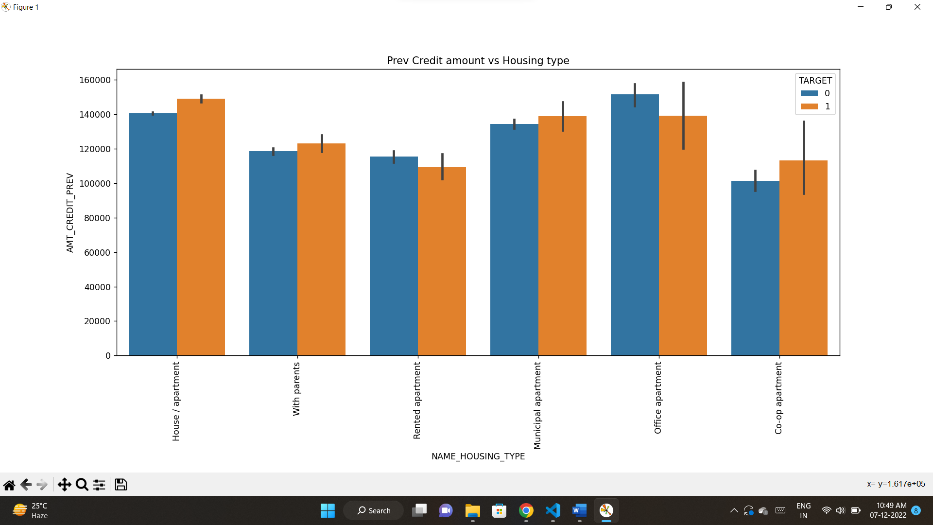
House/apartment has more loan repayment difficulties. So bank need to avoid giving loans to them
Office apartment has more credit and no payment difficulties. So bank should focus on these groups.

Slide 35
CONCLUSION
Bank should focus on Females of Working, Commercial associate and state servant are having high range of income and not having any loan payback issues.
Bank should give less priority to Student, Businessman, Pensioner and Maternity as they having less income, but they didn’t have any payback issues.
Bank focusing Academic degree of married, Civil marriage but also bank can focus on all categories of higher education as they have good income than Academic degree categories also these are having no loan payback difficulties.
As bank focusing on the academic degree most but bank can also focus on the higher education as though they having good income after academic degree.
From previous data we can see that XAP loan purpose are approved most and most of them are having no payback difficulties.
House buying, building a house, buying a land, buying a car these kind of purpose can be focused most as these got more credit in previous.
Office apartment has more credit and no payment difficulties. So, bank should focus on these groups.
House/apartment has more loan repayment difficulties. So, bank need to avoid giving loans to them

Slide 36

THANK YOU

